Slide 1
Enhancing Natural Gas Pipelines using Operations Research
By:
Urvashi Dube
Sudhish Subramaniam
Yesha Gosaliya

Slide 2
Background
In 2018, China National Petroleum Corporation (CNPC) faced challenges due to the increasing demand for natural gas. To expand efficiently, they adopted Operations Research with linear optimization, leading to higher profits and reduced infrastructure repair costs.
The method optimized complex transportation processes affected by varying temperature and pressure, ensuring a steady gas supply. CNPC's success demonstrates the power of innovation in the natural gas industry.

Slide 3
Questions Addressed in this Case:
What is the capacity of the natural gas transportation network?
What is the optimal transmission plan considering gas production, imports, transportation, storage, and sales, based on available natural gas resources, demand locations, and varying gas prices in the network?

Slide 4
Stakeholders
China National Petroleum Corporation (CNPC): The leading player driving pipeline expansion and optimization, aiming to maximize profits and ensure a reliable gas supply.
Government and Regulatory Bodies: Overseeing the energy sector, with a stake in policy and regulations impacting CNPC's operations.
Natural Gas Producers and Suppliers: Other companies in the industry, aligning or competing with CNPC's goals.
Local Communities and Environmental Groups: Concerned about safety, environmental effects, and community engagement.

Slide 5
Customers
Industrial and Commercial Entities: Rely on gas for energy needs, requiring a stable supply.
Residential Consumers: Depend on gas for heating and household use, seeking affordability and reliability.
Power Generation Sector: Gas serves as a crucial energy source for power plants.
Importers and Exporters: Foreign entities involved in gas import/export may also be customers or stakeholders.

Slide 6
Traditional Method Using Spreadsheets
Divide the system into multiple subsystems.
Use Microsoft Excel to establish internal balance for production, imports, transmission, storage, and sales within each subsystem.
Adjust decisions based on the management team's experience and feedback.
Seek a preliminary balance for the entire system by adjusting interflows between subsystems.
Check and iterate if necessary to ensure balanced natural gas amounts in each subsystem.

Slide 7
Models (Objective functions, decision variables, constraints)
Objective Function: Optimize natural gas flow rates, pressure, and temperature in a fixed network topology.
Decision Variables: Nodes - Net supply, pressure, and temperature, Arcs - Flow rates.
- Objective: Maximize total profit (revenue minus purchasing cost) or minimize total cost.
- Constraints: Flow balance, flow range (min and max), pressure range, and physical laws in components (e.g., compressor, regulator valve, pipeline).

Slide 8
Algorithms Used
Mixed Integer Linear Programming: is a mathematical optimization technique used to solve problems with both continuous and discrete variables
Piecewise Linear Approximation: is a method of approximating a complex curve or function by breaking it into smaller linear segments, simplifying the representation while retaining accuracy.
Non- convex optimization Problems are complex mathematical challenges where the objective function and constraints may have multiple local minima or maxima, making it difficult to find the global optimal solution.
Convex relaxation: is a technique used to simplify and solve non-convex optimization problems by transforming them into convex ones, facilitating efficient solutions.
3SCR Algorithm is a Three-Step Consecutive Refinement approach used to improve the accuracy and efficiency of optimization problems by iteratively refining the solution in three stages.

Slide 9
Model (Approach 1)
Model natural gas transmission as a mixed-integer linear programming problem with piecewise linear approximation for small-sized networks.
- Satisfactory results for small problems, but issues arose for large-scale problems.
- Inconsistent optimal values between algorithms in IBM ILOG CPLEX.
- Computation time exceeded the set criterion for large problems.

Slide 10

Model (Approach 2)
- Developed an iterative two-stage framework for solution optimality and accuracy.
- Convex relaxation of nonconvex problem for fast iterations and highly accurate solutions.
- Achieved convergence error within 2% in one second for a Chinese network with 20+ nodes.
- Verified optimal solutions for small-scale networks (up to 100 nodes).
- Challenges in networks with many cycles, leading to potentially long computation times.
Minimizing Energy

Slide 11
Improved Approach (3SCR Algorithm)
Proposed 3SCR algorithm as an enhancement to the iterative method.
Extended convex relaxation to constraints on interconnected pipelines.
Identified conditions where convex relaxation preserves optimality.
Three-stage process:
Solve a convex relaxed model.
If feasible, the process concludes; otherwise, minimize energy in pipelines and update flow rates.
Determine node pressure and temperature based on updated flows.
Achieves satisfactory accuracy for the largest Chinese network (1,285 nodes) when other methods fail to generate feasible solutions.

Slide 12
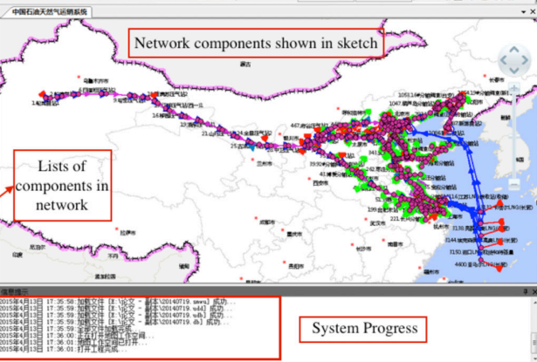
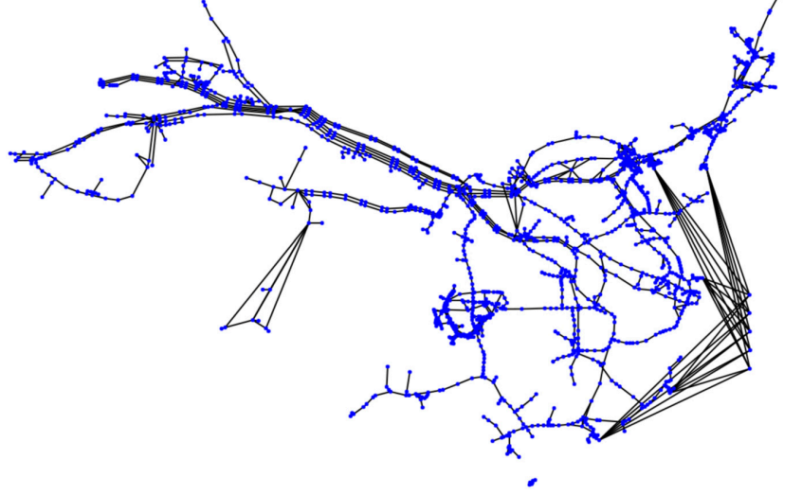
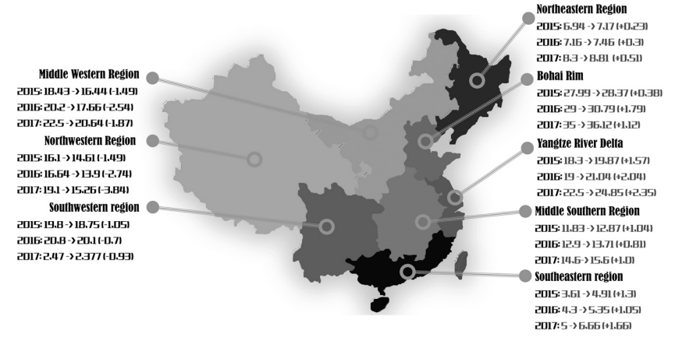
Software Components:
1. Data Input: Importing data from the database and storing it in the system's memory.
2. Data Check: Verifying the correctness of the input data.
3. Unit Conversion: Converting arbitrary numerical data into standard units.
4. Optimization: Solving the natural gas pipeline planning problem using the user-selected algorithm (3SCR or piecewise linear approximation) for efficiency and accuracy.
5. Data Output: Converting and generating the calculation results into the required output formats.

Slide 13
Validation of 3SCR Algorithm (Verification)
- Verified the proposed 3SCR algorithm using real network data, including previous studies, open datasets, and CNPC's network.
- Compared computation time, optimality, and solution accuracy with results from piecewise linear approximation methods in the literature (DeWolf and Smeers 2000, Babonneau et al. 2012).
- Observed that in large-scale networks, proposed algorithm was the only one to generate feasible solutions.

Slide 14
Effect (Advantages)
- Substantial economic impact with increased revenue and budget savings for CNPC.
- Generated over $530 million in additional profits for CNPC's natural gas transmission (2015-2017).
- Optimized allocation of natural gas sales led to increased revenue of $340.3 million.
- Significant improvement in work efficiency, reducing planning time from days to minutes.
- Environmental benefits by providing more accurate customer demand estimates based on improved production and transmission capacities.

Slide 15
References
Jingkuan Han, Yingjun Xu, Dingzhi Liu, Yanfang Zhao, Zhongde Zhao, Shuhui Zhou, Tianhu Deng, Mengying Xue, Junchi Ye, Zuo-Jun Max Shen (2019) Operations Research Enables Better Planning of Natural Gas Pipelines. INFORMS Journal on Applied Analytics 49(1):23-39. https://doi.org/10.1287/inte.2018.0974
He L (2018) 3 critical battles China is preparing to fight. Presentation, World Economic Forum, January 24, Davos, Switzerland.
Sun, Chi Ki, Uraikul, Varanon, Chan, Christine W., & Tontiwachwuthikul, Paitoon. (2000). An integrated expert system/operations research approach for the optimization of natural gas pipeline operations. Expert Systems with Applications, Volume28(2), 397-405. https://doi.org/10.1016/S0952-1976(00)00022-1
Xu, Yizhe, Yan, Chengchu, Liu, Huifang, Wang, Jin, Yang, Zhang, & Jiang, Yanlong. (2020). Smart energy systems: A critical review on design and operation optimization. Sustainable Computing: Informatics and Systems, Volume27, 102369. https://doi.org/10.1016/j.scs.2020.102369
Su, Huai, Zio, Enrico, Zhang, Zong-Jie, Xiong, Chang-Zheng, Dai, Qian-Sheng, Wu, Qing-Wei, & Zhang, Jin-Jun. (2021). Development of an integrated dynamic model for supply security and resilience analysis of natural gas pipeline network systems. Journal of Petroleum Science and Engineering, Volume(in press), 10.1016/j.petsci.2021.10.002

